Slide 1


Institute of Technology of Cambodia
Department of Information and Communication Engineering
Library Management System
Student : Mr. HUN Ravit
Academic Supervisor : Mr. SOK Kimheng
Company Advisor : Mr. SOK Kimheng
Duration : 12 February 2023 – 11 May 2023
Academic Year 2022-2023

Slide 2
Table of Contents
1
INTRODUCTION
2
ANALYSIS AND DESIGN
01
3
IMPLEMENTATION
01
4
CONCLUSION
01
5
DEMONSTRATION
01

Slide 3
INTRODUCTION
1

Slide 4

1. INTRODUCTION
1.1 Company Overview
STEM Library is a collection of science, technology, engineering, and mathematics books and has been developed since 1981 to help students, researchers, and lecturers to do their research activity.
Address : Building I at the Institute of Technology of Cambodia
Tel : (+855) 23 880 369
Email : info@itc.edu.kh
Website : https://www.itc.edu.kh
Duration : 12th February – 11th May 2023

Slide 5
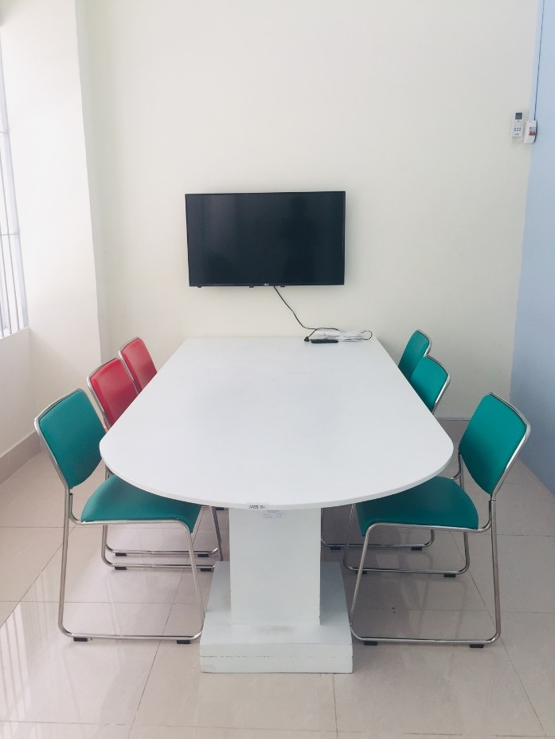
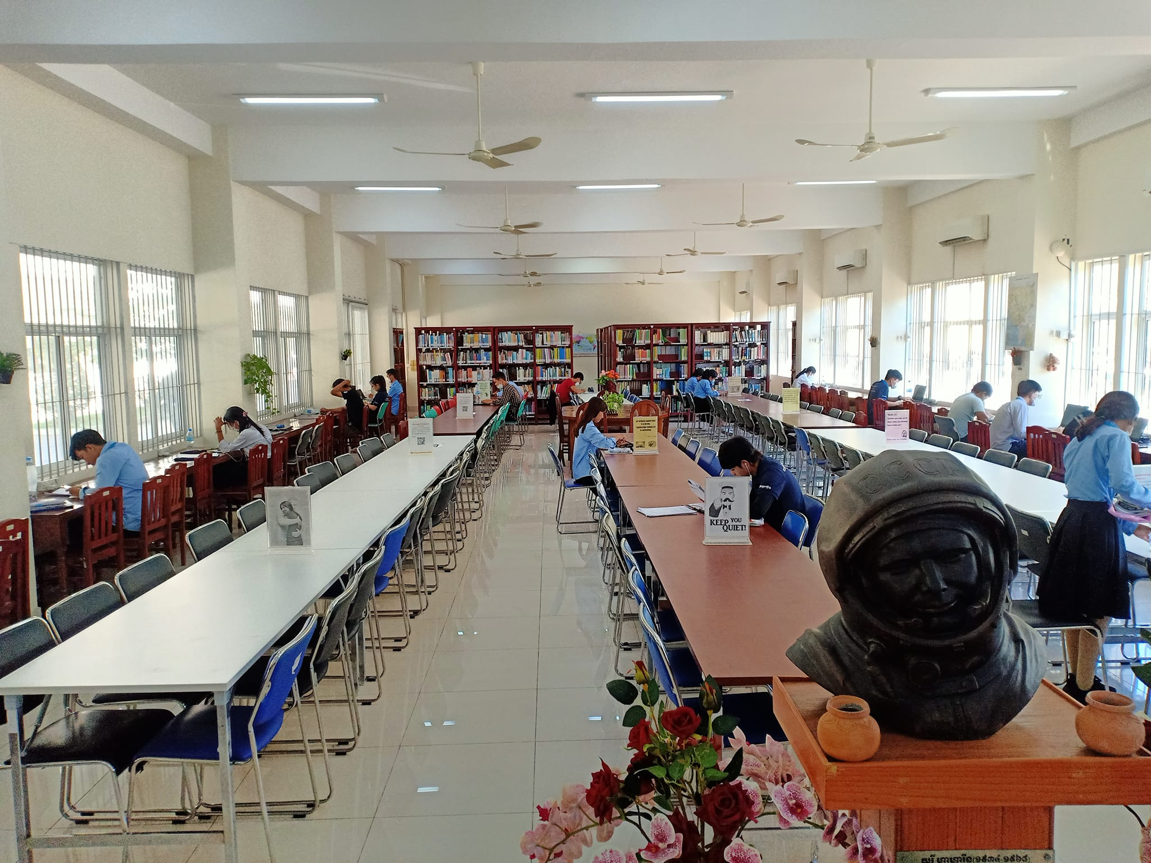
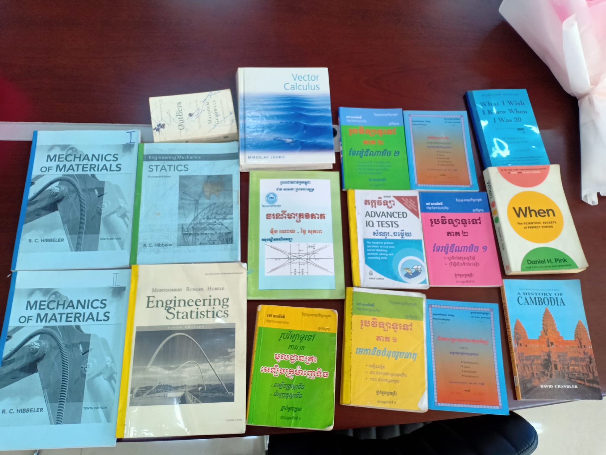
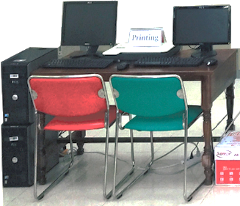
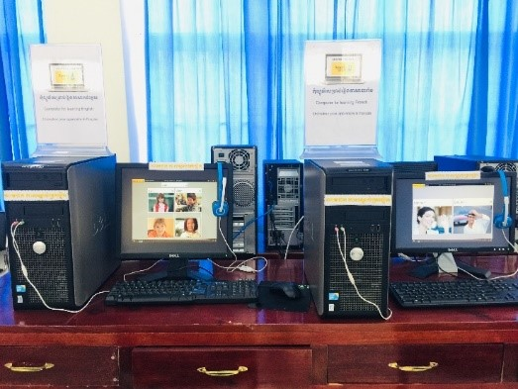
1. INTRODUCTION
1.2 Company service
Place for study
Borrow book
Discussion room
Computer for searching the internet
Printing and Copying

Slide 6

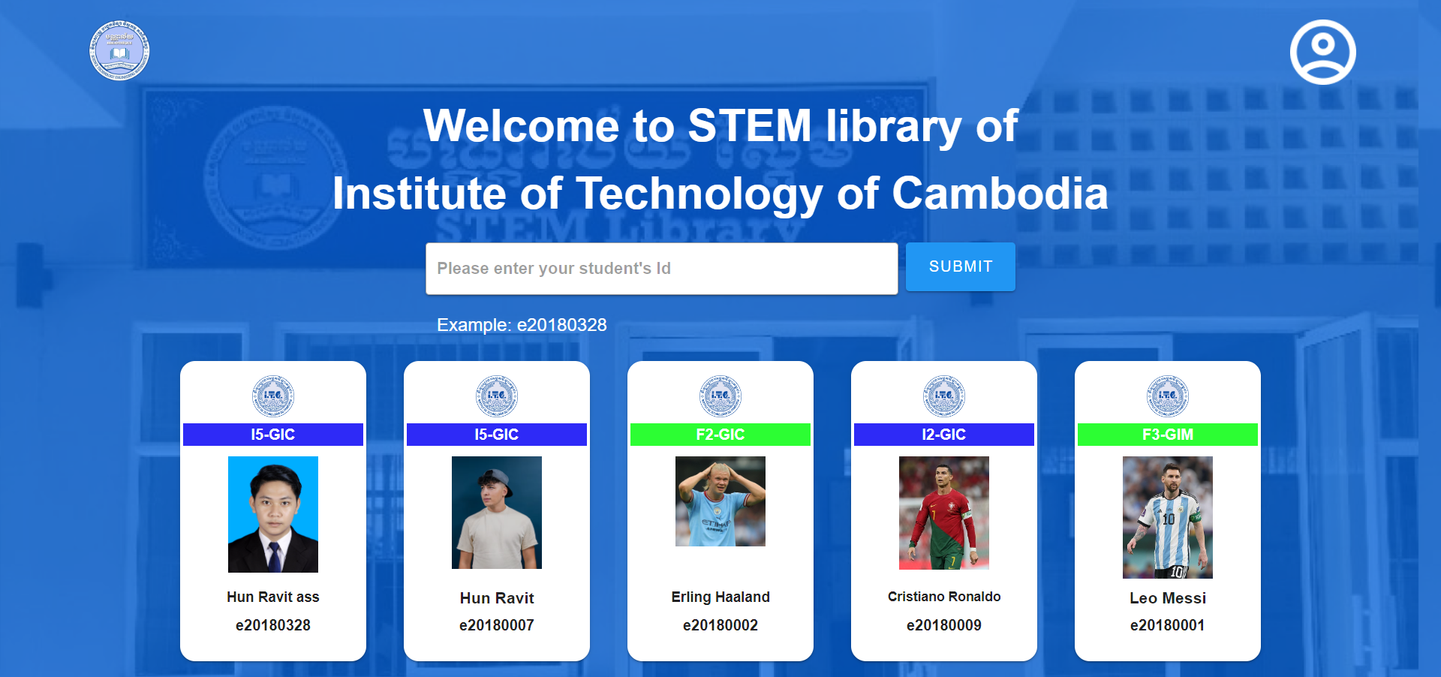
1. INTRODUCTION
1.3 What is Library Management System?
Library System Management is a website project to digitalize the traditional register attendance in Excel to adapt to the new age of IT evolution. It will be used to register all attendance candidates who join the library and find books.

Slide 7
1. INTRODUCTION
1.4 Problems Overview
The reason that we propose to build this system is:
Wasted the recruitment working time checking whether student register names were correct or not
Wested the candidate time to register their name
Difficult to generate the daily, weekly, monthly, and yearly report
Wested time to find the book

Slide 8
1. INTRODUCTION
1.5 Objectives
Build a website application that can provide:
Able to manage candidate type
Can check whether the student id is correct or not
Generate report Excel and Bar chart
Generate a student library card for the candidate
Upload many student information from an Excel file

Slide 9
1. INTRODUCTION
1.6 Project Scope
Library Management System
1
2
3
User and access management
Attendance management
Report management
Login and Register
User Roles
Access control of each roles
Manage candidate type, department, and department option
Manage candidate register
Report of attendance
Report of payment
Report as Excel and Bar chart

Slide 10
1. INTRODUCTION
1.7 Planning
Tasks | Weeks
 | 1 | 2 | 3 | 4 | 5 | 6 | 7 | 8 | 9 | 10 | 11 | 12
Get the requirement
Define the project scope
Wireframing and prototype
Implement
Testing and Bug Fix
Prepare for deployment

Slide 11
ANALYSIS AND DESIGN
2

Slide 12
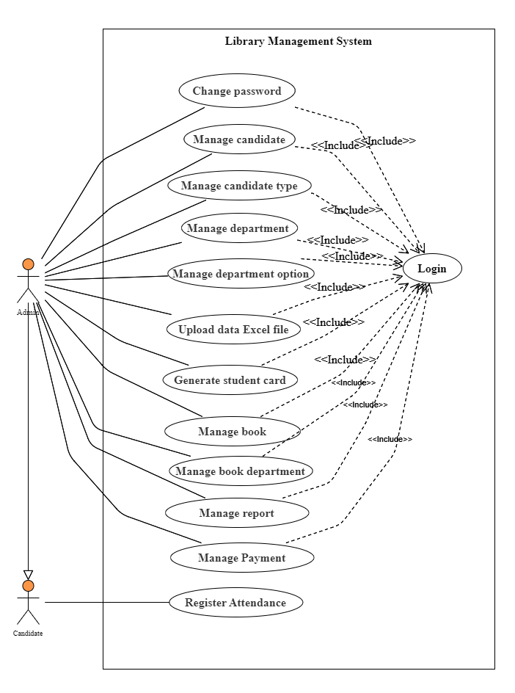
2. ANALYSIS AND DESIGN
2.1 Use Case Diagram
Admin
Candidate

Slide 13
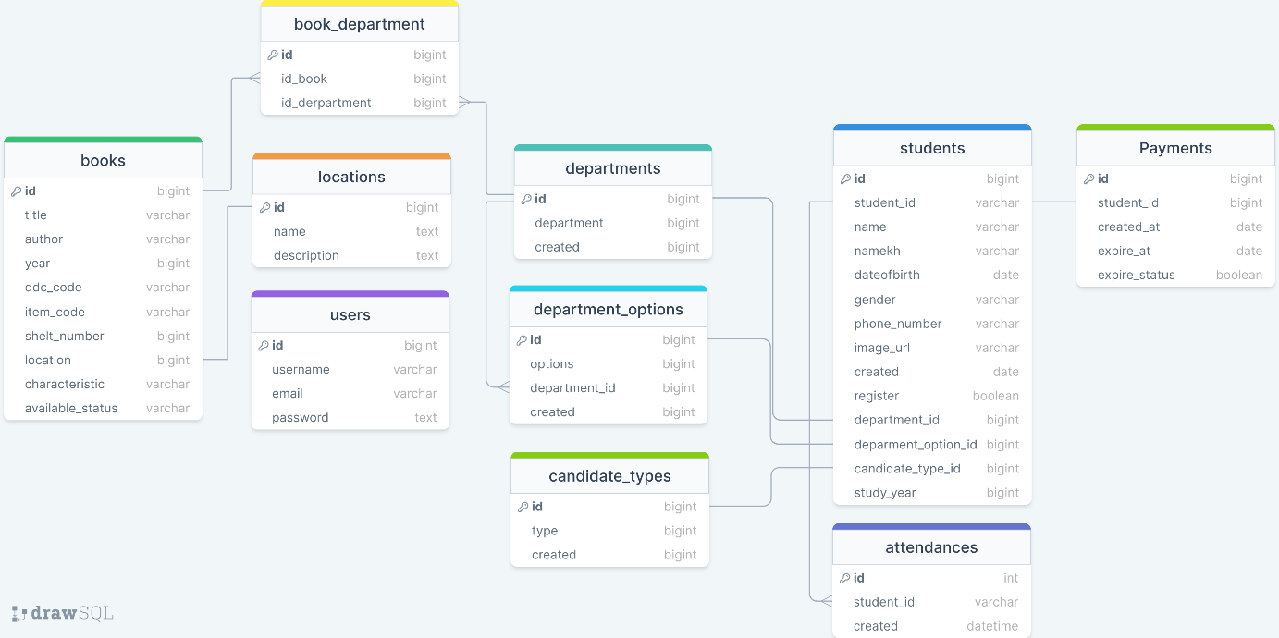
2. ANALYSIS AND DESIGN
2.2 Database Schema

Slide 14








2. ANALYSIS AND DESIGN
2.3 Choice of Technologies
Technologies
Tools
Database

Slide 15

2. ANALYSIS AND DESIGN
2.4 Physical Architecture

Slide 16
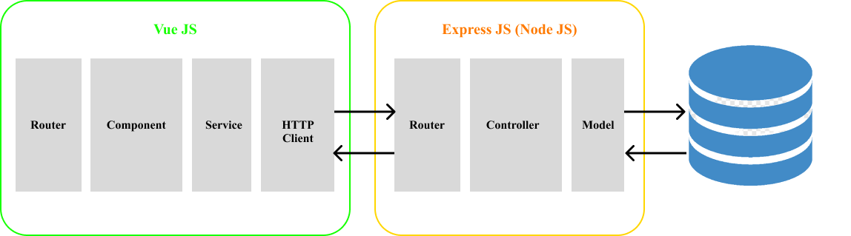
2. ANALYSIS AND DESIGN
2.5 Logical Architecture
MYSQL

Slide 17
IMPLEMENTATION
3

Slide 18
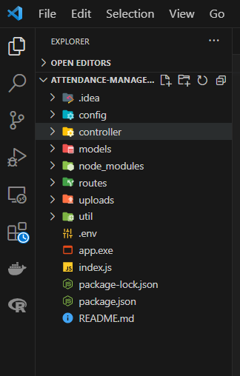
3. IMPLEMENTATION
3.1 Project Structure
config: store configurations such as database configuration
controller: store logically for handling incoming requests
uploads: store all file images and Excel that upload from the user
utils: store helper functions that can be used across the application

Slide 19
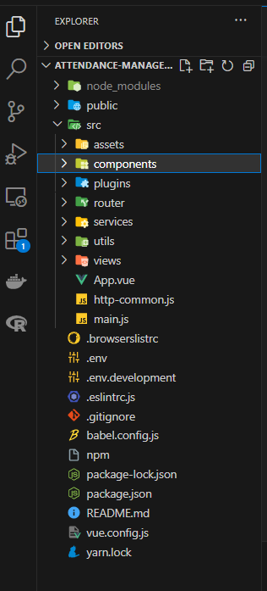
3. IMPLEMENTATION
3.1 Project Structure
component: store component that is re-used multiple time
assets: store images and third-party files
service: store service for communicating with API
views: store all pages design
router: store the Vue router configuration file and path

Slide 20
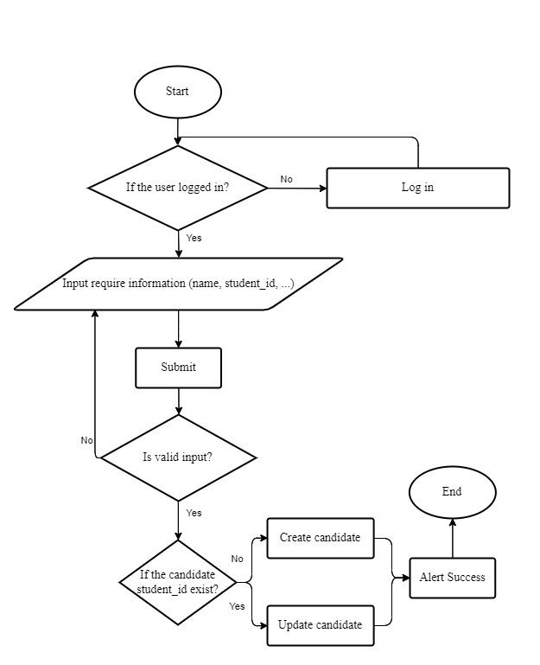
3. IMPLEMENTATION
3.2 Flowchart for create new candidate

Slide 21
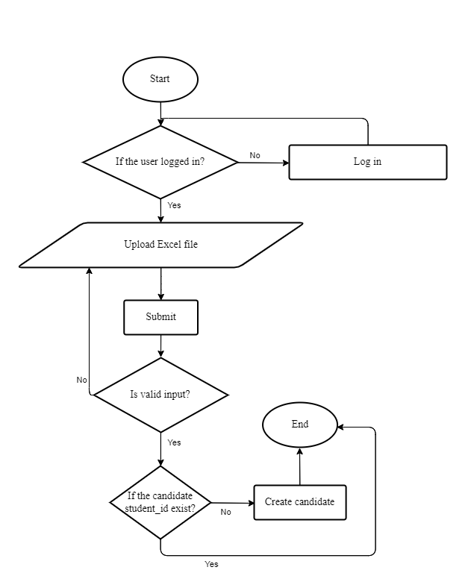
3. IMPLEMENTATION
3.3 Flowchart of upload Excel file (create candidate)

Slide 22
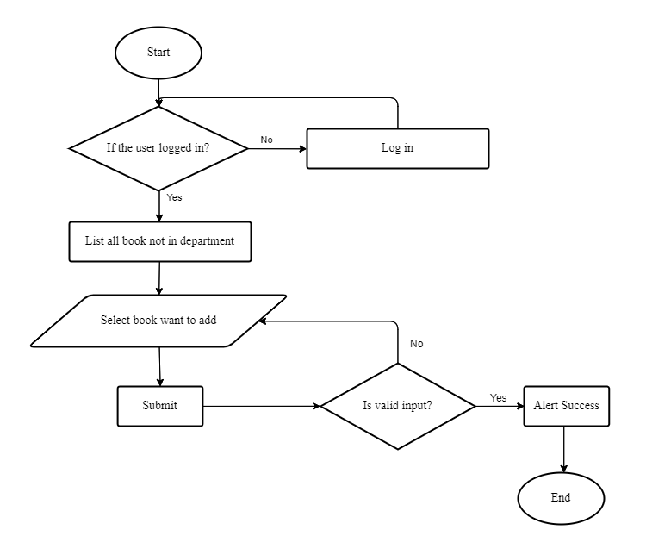
3. IMPLEMENTATION
3.4 Flowchart for add book to department

Slide 23
CONCLUSION
4

Slide 24
4. CONCLUSION
Result
Task | Completed | Uncompleted
Login authentication | ü
Register attendance | ü
CRUD candidate | ü
CRUD candidate type | ü
CRUD department | ü
CRUD department option | ü
CRUD book | ü
CRUD book location | ü
Add the book to the department | ü
Generate report excel | ü
Generate report bar chart | ü
Upload candidate by Excel file | ü
Change password | ü
Generate an image student card | ü
Generate image top ten register | ü
Apply Open Policy Agent |  | û

Slide 25
4. CONCLUSION
Difficulties
Experiences
Dealing with a new library
Learning to manage time
More requirements in the project
Manage time for each task
Learn new technology
Better manage time
Project management and process
Understand how to work with the client

Slide 26
4. CONCLUSION
Perspective
Improve responsive website
Improve code structure
Improve performance code
Complete Access control (Open Policy Agent)

Slide 27
DEMONSTRATION
5

Slide 28
THANK YOU
&
QUESTIONS

Slide 29
REFERENCE
Introduction to Node JS. (n.d.). Introduction to Node JS. Retrieved June 10, 2023, from https://nodejs.org/en
Introduction to HTML. (n.d.). Introduction to HTML. Retrieved June 10, 2023, from https://www.w3schools.com/html/html_intro.asp
CSS Introduction. (n.d.). Retrieved June 10, 2023, from https://www.w3schools.com/css/css_intro.asp
JavaScript.com. (n.d.). Retrieved June 10, 2023, from https://www.javascript.com/
VueJS.org. (n.d.). Retrieved June 10, 2023, from https://vuejs.org/
Vuetifyjs.com. (n.d.). Retrieved June 10, 2023, from https://vuetifyjs.com/en/getting-started/installation/
Mysql.com. (n.d.). Retrieved June 10, 2023, from https://www.mysql.com/
Github.com. (n.d.). Retrieved June 10, 2023, from https://docs.github.com/en
Postman API Platform | Sign Up for Free. (n.d.). Postman. Retrieved June 10, 2023, from https://www.postman.com/
Apachefriends.com. (n.d.). Xampp. Retrieved June 10, 2023, from https://www.apachefriends.org/index.html
Heidisql.com. (n.d.). HeidiSQL. Retrieved June 10, 2023, from https://www.heidisql.com/
IntelliJ IDEA: The Capable & Ergonomic Java IDE by JetBrains. (n.d.). JetBrains. Retrieved June 10, 2023, from https://www.jetbrains.com/idea/

